Slide 1
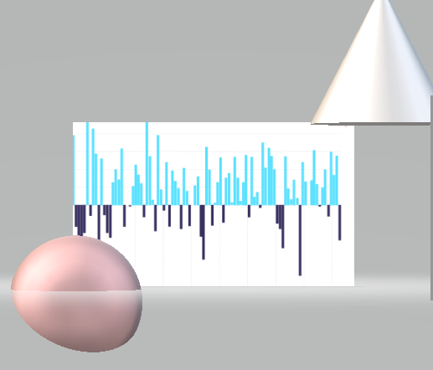
Capstone Project
Stock Excahnge Analysis
Capstone Project
Stock Exchange

Slide 2

Business Objectives
Basic Exploratory Analysis on different metrics available to get insights at the Stock Level.
To analysis the various factors related to Stock Exchange that is Open ,Close, Low ,High Company name etc Price for each listed company.
Technology-wise Objective : Creating an End-to-End Pipeline to enhance the automation to do quick analysis and manage all the repetitive actions in a proper-structured manner.

Slide 3

Data Description
There are Two Table(Records) :-
1. Stock Companies
2. StockPrice

Slide 4
Data Description
Stockcompanies.csv
symbol STRING not Null
Security STRING not Null
Sector STRING not Null
Sub_Industry STRING not Null
Headquarter STRING not Null
2.StockPrices.csv
Date DATE
symbol STRING not Null
Open DOUBLE not Null
Close DOUBLE not Null
Low DOUBLE not Null
High DOUBLE not Null
Volume INT not Null

Slide 5









Technology Stack
Linux Commands (to run the bash script)
PostgreSQL(to create database - RDBMS)
Sqoop (Transfer data from PostgreSQL Server to HDFS/Hive)
HDFS (to store the data)
Hive (to create database)
SparkSQL & PySpark (to perform the EDA)
SparkML (to perform model building)
git (for version control)

Slide 6
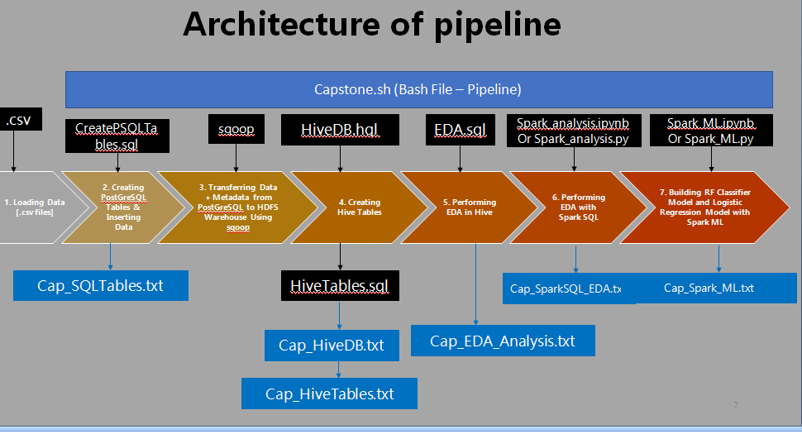

Slide 7

Challenges Faced
Importing the Data from Linux to Hive
Fetching the Hive tables in Spark (Jupyter Notebook Environment)

Slide 8

Inference
conducting stock data analysis, several inferences can be drawn to gain insights into the performance and trends of a particular stock.
By analyzing historical stock data, we can identify patterns and trends in price movements. This information can help to assess the stock's volatility, growth, and overall performance over time.
Price and Volume Relationship: Examining the relationship between stock prices and trading volumes can provide insights into market sentiment and investor behaviour. Higher trading volumes during price increases may indicate increased buying interest, while higher volumes during price declines may suggest selling pressure..

Slide 9
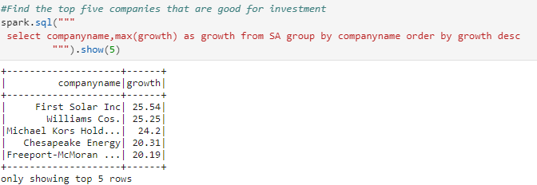
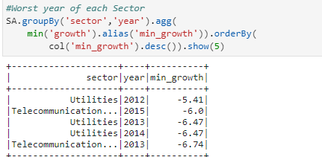

Slide 10
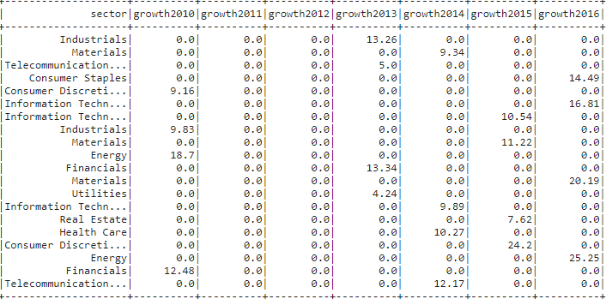
Year wise maximum growth of Companies

